Slide 1
Executive Summary:
Lifetime Value Modeling for Distributor Management
Key Insight:
Distributor LTV must capture not just purchases, but recruitment, training, and network impact.
Predictive Feature Highlights:
• RFM + time-based cadence
• Network/downline activation metrics
• Engagement & skill signals
• Uplift (incremental) modeling
• Survival analysis for lifetime prediction

Slide 2
Market Benchmarks (2025):
• Avg Retail CLV: $168
• Subscription CLV: $1,200+
• Direct Selling CLV (est.): $420
• CLV:CAC healthy ratio: 3:1
• Repeat purchase rate: 15–30%

Slide 3
Strategic Recommendations:
• Build hierarchical LTV models
• Use uplift ML for interventions
• Implement real-time scoring via feature stores
• Track downline activation, churn, and ARPU
• Apply explainability (SHAP) for business trust

Slide 4
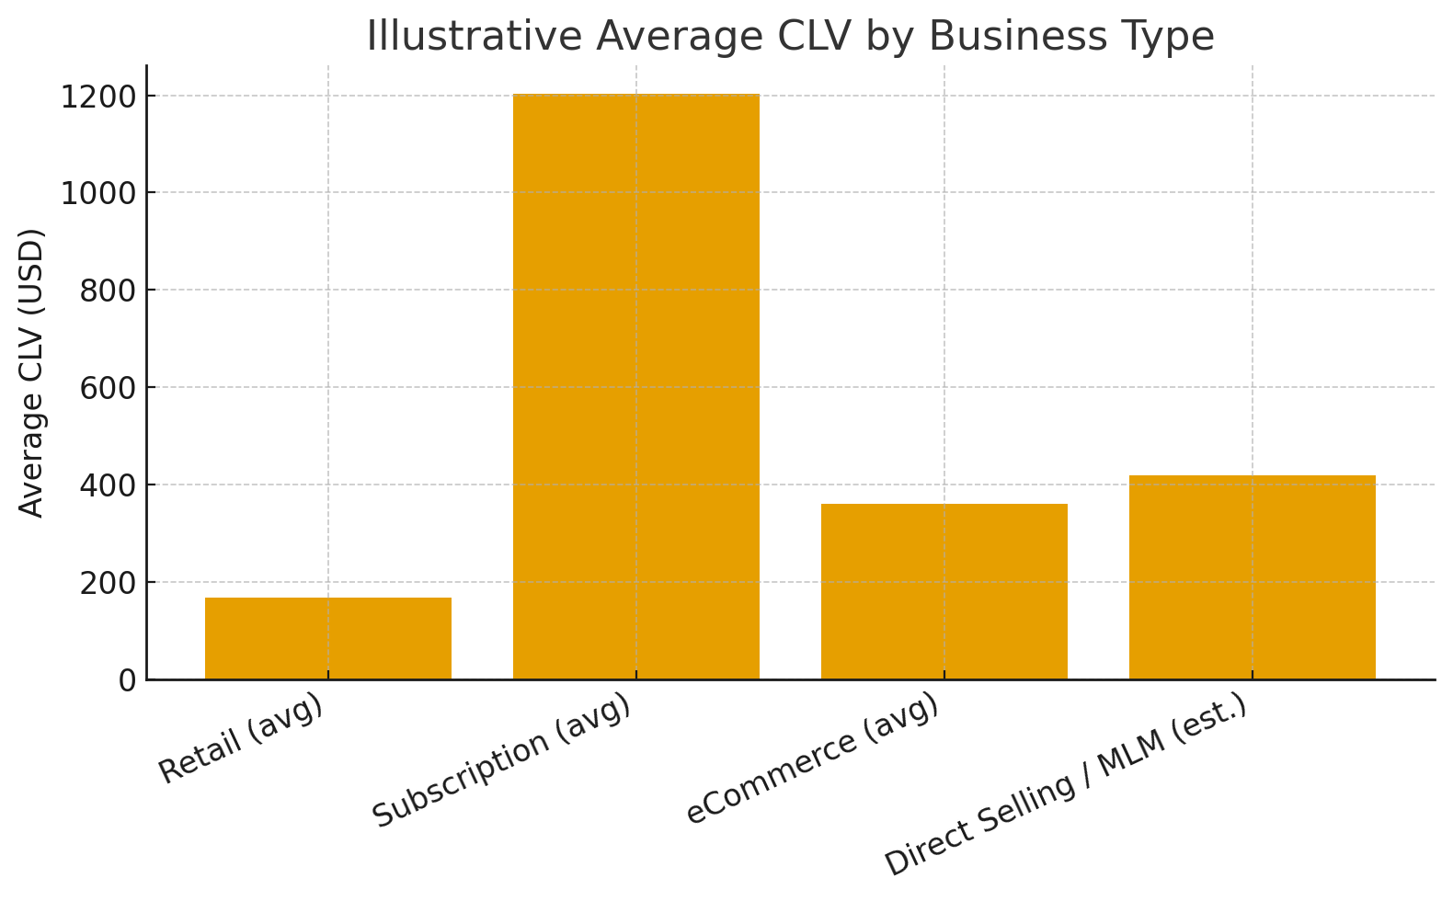
Outcome:
Companies applying advanced LTV modeling achieve 10–25% better retention and ROI on distributor incentives.

